Slide 1

Sports Analytics
SPORTS IS BIG BUSINESS
August 2019

Slide 2
Topics
Follow the Money!
  Worldwide Estimates of Sport Revenue
  Pro Revenues, by League
  College Revenues
Adoption of Analytics
  Analyst Job Descriptions
Rest of the Money Eco-System

Slide 3
Overview: Sport is
Big Business
FOLLOW THE MONEY!
How much Revenue?
Price Waterhouse Cooper predicts
$145B revenue WW in 2015
$66.3B in North America
Sources
Worldwide: http://www.pwc.com/gx/en/hospitality-leisure/changing-the-game-outlook-for-the-global-sports-market-to-2015.jhtml
North America: http://www.pwc.com/gx/en/sports-mega-events/news/sports-outlook-north-america-2014.jhtml
Warning: all the data in this section is current from the internet as of July 2019, but there are notable lags in reporting, e.g., some data reported on the Internet is from 2017!
Notes:
Teaching Notes for Sports Analytics
Module 1 – Sport is Big Business (PowerPoint)
Provided by Dr. Dave Schrader, drdaveschrader@gmail.com
Motivation: The purpose of this module is to provide students a quick synopsis of the size of the market for sports. As part of the entertainment/leisure category, sport dollars include money from tickets, merchandise sales, sponsorships, and of course, television and radio. A second goal other than setting a foundation is to educate students that in many ways, sport is no different from any other industry. Decisions are constantly being made that can impact a team’s revenues, and analytics is fairly new tool for most of these team
This module covers a variety of sports, including international ones (although the bias for American sports will be crystal-clear). The educational goals for this module include:
Students should be aware of the size of the sports market
They should become aware of the various components of revenue sources
Depending on interest, they should be able to go find additional revenue information about their favorite sport or team
There are various estimates of the industry revenues depending on what revenue sources you count. Don’t’ get hung up on this

Slide 4
Sport is a Business Segment, just like Financials or Utilities
Each team has employees (coaches, players, managers, trainers, ...), sells a product, has revenues and expenses, even pays taxes.
Individual sports teams (such as Manchester United soccer and the Seattle Seahawks football team) are small to medium size businesses with revenues in the hundreds of millions of dollars.
Above and beyond the teams, Sports Leagues (such as the Premier League and the NFL) are BIG Businesses with revenues in the billions of dollars because of media contracts.
Just like when running any other business, better decisions can be made by using data and analytics!

Slide 5
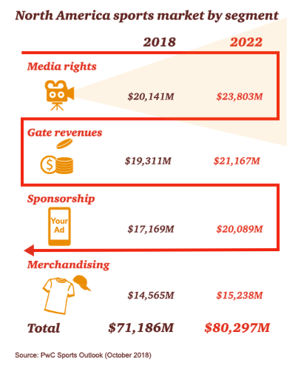
What’s the Revenue Mix?
(North America data)
4 components make up the bulk of revenues to sports orgs
Media rights has eclipsed gate revenues
Sponsorship income is right behind, then merchandising
This data is from 2018, with a projection to 2022: healthy growth!
Source: https://www.pwc.com/us/en/industries/tmt/library/sports-outlook-north-america.html

Slide 6
Pro Revenues

Slide 7
Sport is Big Business – Pros in the USA
Which American Pro Sports generate the most revenue?
NFL $12.9B $402M/football team
MLB $10.4B $346M/baseball team
NBA $7.1B $236M/basketball team
NHL $4.9B $1158M/hockey team
MLS $851M $38M/soccer team
But is this too USA-Centric? YES!
QUIZ
Source hMar 7, 2019 article ttps://globalsportmatters.com/business/2019/03/07/tv-is-biggest-driver-in-global-sport-league-revenue/
Notes:
these numbers break out information by pro American sport. A key point at the end is that MLS is small compared to international soccer leagues (next page). You can ask students which is the highest value worldwide.

Slide 8
ACRONYMs CHEAT SHEET
CBS, ESPN, NBC, Fox – Sports Broadcast Networks
MLB – Major League Baseball
MLS – Major League Soccer
NBA – National Basketball Association
NCAA – National Collegiate Athletic Association
NFL – National Football League
NHL – National Hockey League
OVERVIEW : https://en.wikipedia.org/wiki/Major_professional_sports_leagues_in_the_United_States_and_Canada and https://en.wikipedia.org/wiki/List_of_professional_sports_leagues
Notes:
Acronyms in case you do not know the American leagues for various sports, or the major TV channel devoted to sports “Entertainment and Sports Network” ESPN

Slide 9
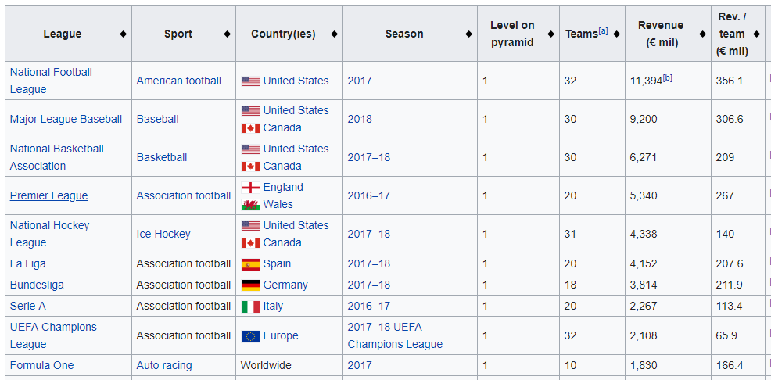
Wikipedia List of Leagues/Revenues
(1 Euro is $1.13 USA)
Source: https://en.wikipedia.org/wiki/List_of_professional_sports_leagues_by_revenue

Slide 10

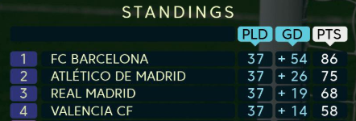

International Soccer Revenues
$5.3B Premier League
$4.2B La Liga (Spain)
$3.8B Bundesliga (Germany)
$2.3B Serie A (Italy)
$2.1B UEFA League
$1.6B Ligue 1 (France)
$1.3B Campeonato (Brazil)
And on and on
Source: Leaguehttps://en.wikipedia.org/wiki/List_of_professional_sports_leagues_by_revenue /
Notes:
here are the numbers for the top Soccer (“Football” outside the USA) leagues – they stack up quite favorably against American pro leagues

Slide 11
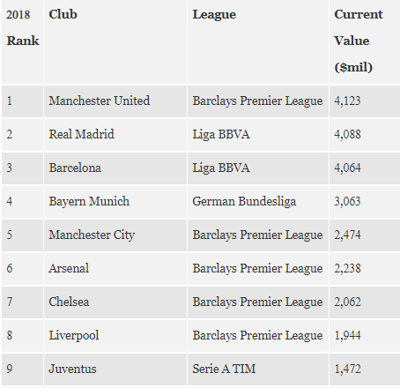

Soccer Valuations Are Huge
Manchester United is the most valuable team, worth $4.12B, with $254M of revenue.
Source; https://www.forbes.com/sites/forbespr/2018/06/12/forbes-releases-15th-annual-list-of-the-worlds-most-valuable-soccer-teams/#2915f8924762

Slide 12
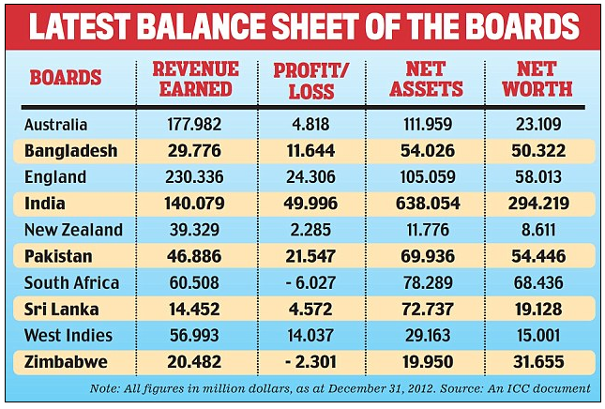
Cricket Has Big Revenues, Too!
Indian Premier League; Brand Value $6.3B (2017, not revenue)
Big revenue sport in England, India and all the Commonwealth countries
Source; http://www.dailymail.co.uk/indiahome/indianews/article-2338491/Scandal-hit-BCCI-makes-highest-profit-Test-playing-countries.html
Notes:
in an early test version of this, the Indian students wanted to know about cricket, so I added this page. The tallies are by league (so you can compare, for example, the British Cricket League to MLS). Most Americans have no idea that cricket is this big!

Slide 13
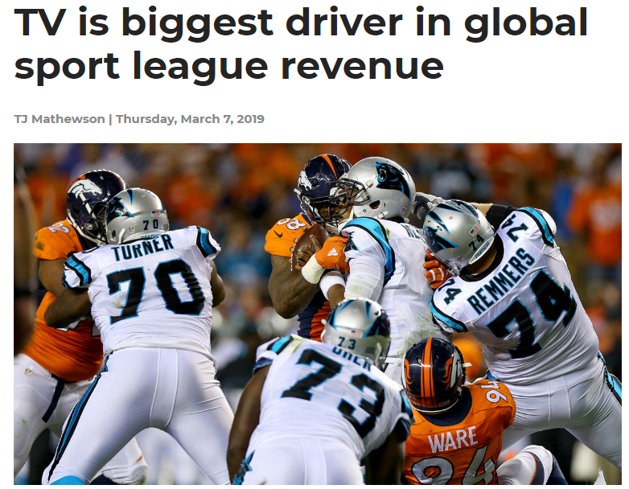

Media
According to Statista, the NFL will collect $54.6 billion from TV contracts with FOX (runs from 2014-2022), CBS (2014-2022), NBC (2014-2022), ESPN (2014-2021) and DirecTV (2015-2022).
With so many people watching the Super Bowl, the networks command ever-increasing ad rates for 30- and 60-second commercials. For Super Bowl LII, NBC charged $5 million for a 30-second commercial spot and exceeded $1.4 billion in ad revenue. For Super Bowl LIII, CBS charged between $5.1 and $5.3 million for a 30-second spot.
Source: https://globalsportmatters.com/business/2019/03/07/tv-is-biggest-driver-in-global-sport-league-revenue/

Slide 14
College Revenues

Slide 15
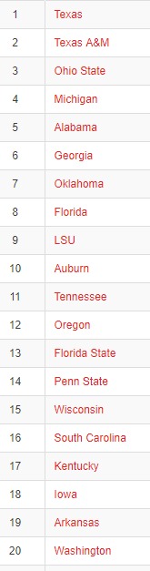
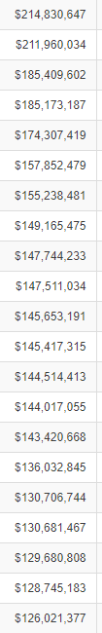
Sport is Big Business for USA Colleges
31 schools* generate more than $100M/year in revenues
College Football $3.4B
  Includes the ESPN 12 year contract at $5.6B to broadcast playoffs and 6 bowls ($470M/year)
College Basketball $1.4B (est.)
  $10.8B 14 year contract with CBS Sports/Turner
NCAA generated $918M (2013)
* Private schools like USC and Stanford not included
Source: https://sports.usatoday.com/ncaa/finances/
Source; http://sports.usatoday.com/ncaa/finances/
Notes:
A key point is that anything that is happening at the Pro level will be driven down into the university sports teams. Out of the Sports budgets at most schools, American football is the big revenue producer (basketball is in 2nd place). NCAA revenues for schools come from TV revenue, although there is a new trend for local conferences (like the Big 10 and SEC conferences) to start creating their own TV networks.

Slide 16
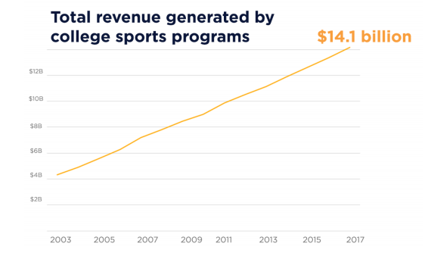
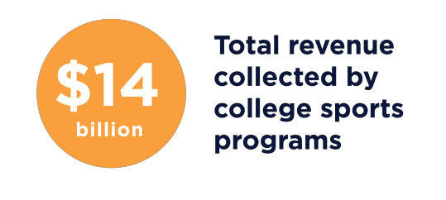
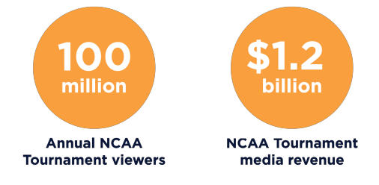
College Revenues
MARCH MADNESS BASKETBALL STATS:
VERY INTERESTING STUDY:
Source: https://www.murphy.senate.gov/download/madness-inc

Slide 17
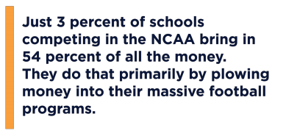
Football Drives Revenues, But Skewed Distribution
College football, and to a lesser extent basketball, dominates the industry. The average FBS (Football Bowl Subdivision) school, which is any Division I school with a football team, makes more revenue from football, $31.9 million each year, than it does on the next 35 sports combined, $31.7 million.
Within football and basketball, an exclusive group of colleges bring in most of the money. The Power Five conferences (ACC, SEC, Big Ten, Big 12, Pac-12) include 65 of the most successful schools in college sports, both athletically and financially. Those programs brought in more than $7.6 billion in revenue last year.
Out of the 2,078 institutions that have athletic programs, those 65 schools generated 54 percent of all college sports revenue.
Source: https://www.murphy.senate.gov/download/madness-inc

Slide 18
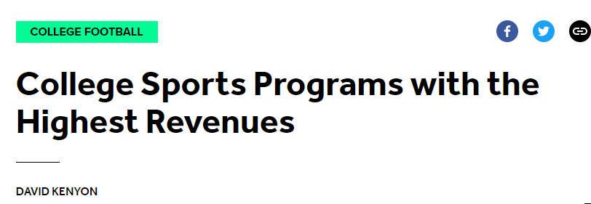
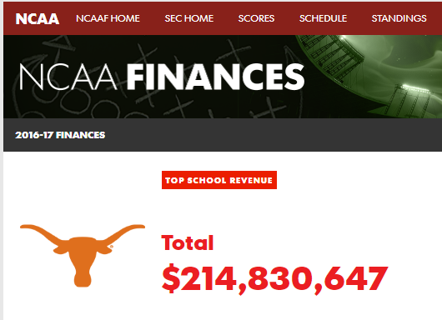
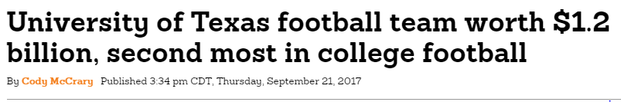
https://www.mysanantonio.com/sports/college_sports/longhorns/article/University-of-Texas-football-team-worth-1-2-12218699.php; Ohio State is #1 but the date on this is from 2017, data from 2016!
This is the latest data but it is old, from 2016-2017
Source: https://bleacherreport.com/articles/2795760-college-sports-programs-with-the-highest-revenue#slide0 and https://sports.usatoday.com/ncaa/finances/

Slide 19
Sport is Big Business
Just like when running any other business, better decisions can be made by using data and analytics – and that’s the focus of the rest of this presentation
Most pro teams split the organization into two groups
    Business Operations
    Team Operations
Now let’s talk about the state of the art with regard to hiring Analysts. This is widespread in businesses, but other than the front-office, relatively new to sports (but increasing).
Notes:
Summary slide. This sets up a couple of points that will help with the segue to Module 2, where we drill down into details of the various uses of data to make better decisions. Two good open-ended questions for discussion to close out this module would be:
Can anyone think of examples where data collection and analysis could help a team or player make better decisions?
Are there analogies between the world of business and the world of sports? What can sports teams learn from business uses of data and analytics? What can business people learn from sports team’s uses of data and analytics?
If you are teaching in an area with some teams, you might want to augment the materials here with more details about the local team, or give students a homework assignment to go research online data about the local team(s).

Slide 20
Adoption of Analytics in Sports
Sample Job Descriptions
Here’s where it gets interesting
Sport as an industry is – by and large – way behind the state of business
Hiring is happening now at the pros to build out analytics staff, more on the business side than the back office who still depend on “eyeballs” (scouts) more than numbers
Pro leagues do employ a considerable number of analysts and often they help the various teams in the league
Colleges are way behind. At big schools, maybe 1-2 analysts to help the business office. In the team area, they may have analysts to help selected revenue sports, but that’s about it. Very weak in the back office compared to what you might expect.
The activities you do as a sports analytics person are not much different from what you would do in business, but
  The data sets may include things like sensors or video
  The predictive models may be on things like next play or next injury

Slide 21
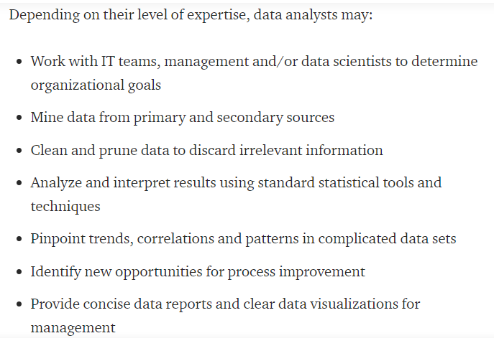

What Do Analysts Do? (With Additions in RED for Sports)
Plus ADs, business office, coaches, trainers
Sensors, video,
social media
e.g., scouting
e.g., for Athletic Directors, Coaches, Ticket Sales,
Donor Development
Source: https://medium.com/@randerson112358/data-analytics-data-science-30150f7b62aa

Slide 22
Sample Job Descriptions

Slide 23
Things Are Changing –
Current Job Offers on Glassdoor – Pro Level
Here is a sampler of the kinds of jobs on Glassdoor.com across the different areas of sports analytics for pro and college teams. A sampler of jobs as of July 2019 includes:
Front Office: Business Analyst for the Carolina Panthers (Football) and Portland Timbers (Soccer)
Back Office: LSU Football, Robert Morris U (these usually will not be found on places like Glassdoor – it is much more word-of-mouth and who-knows-who)
League: NBA Analyst and a Data Architect for an NFL Health and Safety System

Slide 24
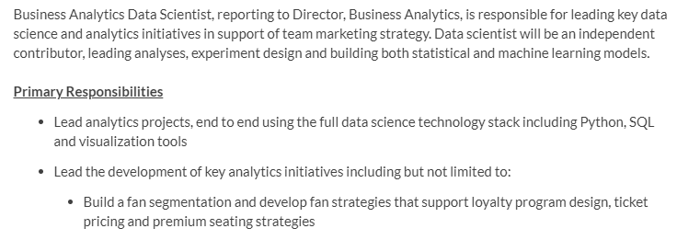


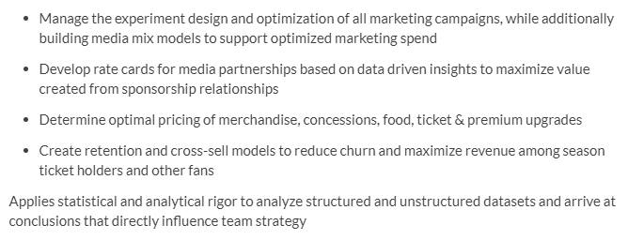
Football Front Office: Carolina Panthers Business Analyst

Slide 25

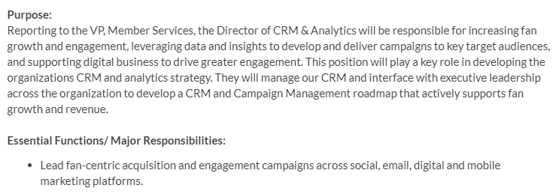

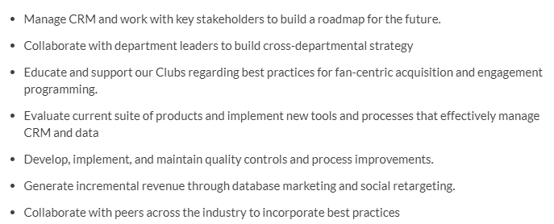
Soccer Front Office: Portland Timbers – Soccer

Slide 26


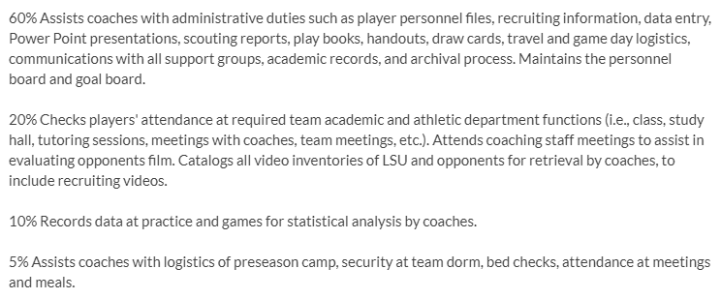
Football Back Office: Coach Support
Despite the label, this is a typical entry level “Go-Fer” job, which entails some analytics work, but mostly involves helping the head coach with logistics of all kinds.

Slide 27


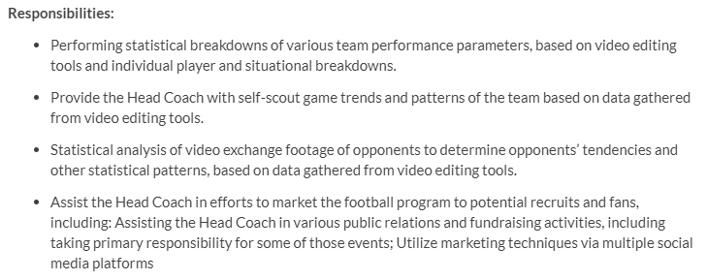
Football Back Office: Quality Control
Often instead of “Data Analyst”, teams will call this function “Quality Control”

Slide 28

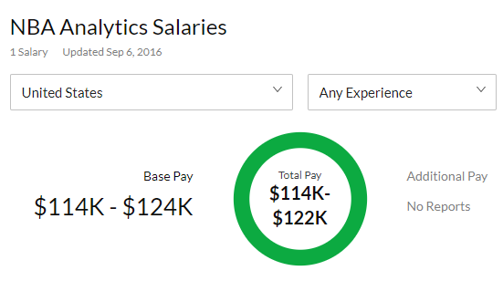

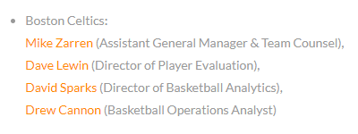
NBA Basketball Analytics
Look up your favorite team and you will find the list of analysts!
Source: https://www.nbastuffer.com/analytics101/nba-teams-that-have-analytics-department/

Slide 29
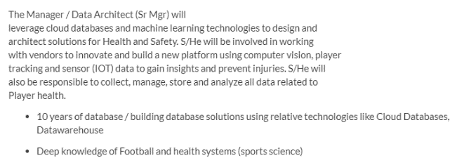
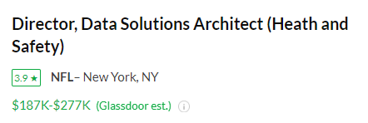
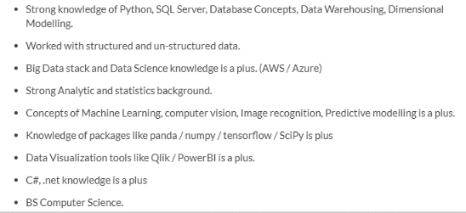
NFL – Health and Safety Data Architect

Slide 30
Adoption Rates for Analytics

Slide 31
Adoption Rates for Pro Sports Analytics
All over the map
Pros: all pro teams now have analytics groups, but each sports is at a different stage
  At the industry level, baseball is the most mature, then basketball, soccer and football. Hockey has lagged.
But within each industry, some teams are definite leaders, others are laggards.
Often you will find pockets of good analysts at the League Office, helping all the teams

Slide 32
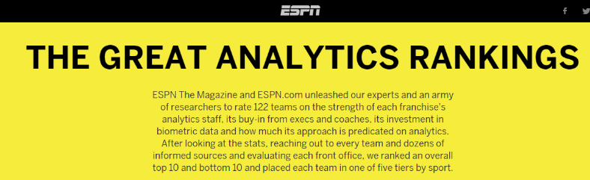
“There are caps on how many players you can have on your roster, but no limit on the number of analysts” – Pro GM
How many and how good are they?
Practically every pro team has launched analytics efforts
In 2015, ESPN rated which teams are ahead and which are behind in the use of analytics. Click the link to see how your favorite team stacks up!
Unfortunately, this study has not been updated!
Source: http://espn.go. mco/espn/feature/story/_/id/12331388/the-great-analytics-rankings/
Notes:
Most of the pro teams are adding analytics staff. Data collection and insight generation is viewed now as a competitive edge. That’s one reason why this is an interesting area – it’s just like where the business world was 10 years ago when Tom Davenport wrote Competing on Analytics (which I assume you know as a landmark book in analytics). While most teams are not eager for competitors to know what they are doing (just like many businesses don’t want people to know their secret sauces), there is enough information for ESPN to write an article on which teams are “with the analytics program” and which are behind. It’s also the case that each sport is at a different point of maturity with regard to the adoption of analytics. You might ask the students to guess which sports are “ahead” and “which are behind”. You can give a homework assignment from this page for students to go find out the answer for their favorite sport – who is behind and who is ahead, and why?

Slide 33

Many Analysts Attend the MIT SSAC https://en.wikipedia.org/wiki/MIT_Sloan_Sports_Analytics_Conference
MIT Sloan Sports Analytics Conference (SSAC)
    14th Annual, March 6-7, 2020
    Panels
    Research track
Huge event – more than 3000 attendees in Boston
You can count how many analysts from each pro team attend – it’s been going up!
http://www.sloansportsconference.com/archive/videos/
We’ll be recommending numerous videos from this conference
Notes:
the MIT conference is the premier conference in the sports analytics area. You should spend some time reading the other modules, taking a look at some of the research papers and videos referenced there before presenting this page

Slide 34
The Rest of the Ecosystem
Other sports revenue sources than tickets, media

Slide 35
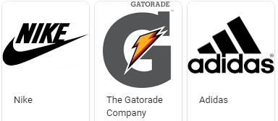

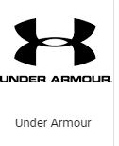
Other Aspects of Revenue
All pro orgs and the big colleges have full-time people who work in these areas of additional revenue
Corporate sales, box suite sales, other perks like on-the-field seats
Sponsorships
Parking
Concessions
All of these groups need analytics people, too!

Slide 36
Summary
By reading this deck, you should now be aware of the “size of the prize”, have an understanding of revenue totals, know the top sources of revenues
In addition, you should have a feel for the various kinds of jobs in sports that require some analytics skills

