Slide 1

Sports Analytics
LEARN ON YOUR OWN
August 2019

Slide 2
What’s Here
The world of sports analytics is rapidly evolving so you can learn a lot by reading books, browsing websites and watching videos
In this writeup, we give you some tips on the best materials that will help you educate yourself
Notes:
highlights the general field of strength and fitness, the associated coaching staff, and why this is an important area. One side comment you can make is that students who study this area have an extra advantage in that even if they do not get a job with a sports team, all of the skills they learn are relevant topics for healthcare in general, a booming job field.

Slide 3
Books – Across Multiple Sports
These are good overview books to read that show how analytics can be used for multiple sports:
Analytical Methods in Sports by Thomas Severini
Sports Analytics and Data Science by Thomas Miller
Scorecasting: The Hidden Influences Behind How Sports are Played and Games are Won by Tobias J. Moskowitz and L. Jon Wertheim
Mathletics – How Gamblers, Managers, and Sports Enthusiasts Use Mathematics in Baseball, Basketball, and Football by Wayne L. Winston
Sports Performance Measurement and Analytics by Lorena Martin
Notes:
highlights the general field of strength and fitness, the associated coaching staff, and why this is an important area. One side comment you can make is that students who study this area have an extra advantage in that even if they do not get a job with a sports team, all of the skills they learn are relevant topics for healthcare in general, a booming job field.

Slide 4
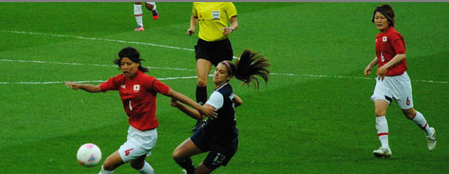
Books By Sport
Baseball: Visualizing Baseball by Jim Albert, or Power Ball by Rob Neyer. Or The MVP Machine by Ben Lindbergh and Travis Sawchik.
Basketball: Basketball Analytics by Stephen Shea and Christopher Baker
Football: Take Your Eye Off the Ball 2.0 by Pat Kirwan
Golf: Every Shot Counts by Mark Broadie
Hockey: Stat Shot: A Fan’s Guide to Hockey Analytics by Rob Vollman,
Soccer: Why Everything You Know About Soccer is Wrong by Chris Anderson and David Sally
Notes:
A good example from women’s soccer and why Zebra tags are used for health and safety. Generally (because of money) the women’s teams will lag the men’s teams (mostly because of funding) but once the technology and benefits are proven, expect wider use.

Slide 5

Online articles and videos
MIT Sports Analytics Conference Research Paper and Posters
  The latest research papers can be found here: 2019 Research Paper Finalist Posters. We recommend you also review previous years' research posters for more inspiration.
SportTechie.com covers the evolution of technologies for sport
Review any of the Editor Choice (free access) articles in the Journal of Quantitative Sports Analysis in Sports
Notes:
Also https://www.eng.vt.edu/news/virginia-tech-announces-football-helmet-ratings-update-five-new-helmets-meet-five-star-mark
Read more: http://www.momsteam.com/health-safety/football-helmets-reduce-concussion-risk-study-says#ixzz3VXqr72JO
ask the students if they have heard about the problems associated with concussions. This is especially a concern in football, rugby, hockey, and soccer. Not all helmets are equal in their protection capabilities. Fortunately, there is research on what helmets work best at Virginia Tech and at Purdue (my alma mater), which appears on these 2 pages. They have labs where they have sensors inside the helmets that register the impacts (and the protection capabilities) so that the people who buy helmets (equipment managers, but also parents for youth leagues) know what they are buying. The slide shows a 5 star “great” helmet, and a “bad” one. Helmet manufacturers also gather a lot of data to improve their products. Virginia Tech has come up with a metric – a Generalized Concussion Index – that is used to rate the probability of getting a concussion from any particular helmet’s use throughout the season. You could easily give the students a homework assignment to go read about concussions and these lab efforts. If the students have math skills, then have them explore the equations and the terms and be ready to discuss. (Ideally, down the road, I will try to get some helmet data from these schools for students to plot and analyze.)

Slide 6
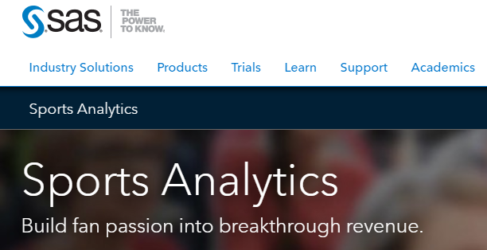
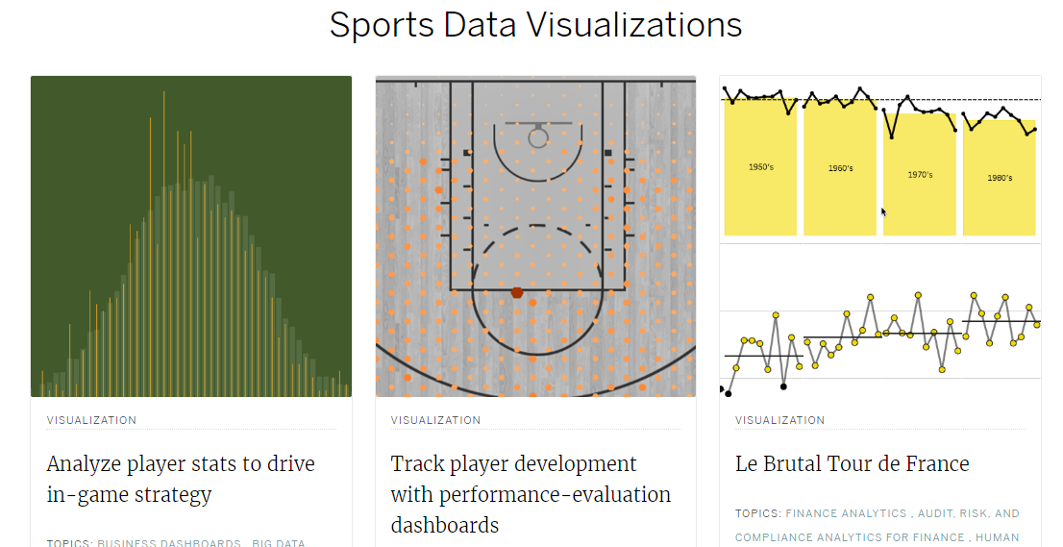
Partner Websites
SAS Sports Analytics: Read stories about the Orlando Magic, the NY Mets, and the University of North Carolina.
Tableau Sports Visualizations: A collection of various ways of visualizing sports data across all the sports.
Notes:
Now (April 2015) moving from football into hockey helmets – controversial per the manufacturers

